Slide 1
Advance Mailing Technique using Color Code Based Substitution with Multiple Language Support

Slide 2
PROBLEM STATEMENT
To solve the current lack of highly encrypted mail service using triple encryption using steganography and multi language support for highly important or secretive communication.
Man-in-the-Middle attack has became a biggest threat to mailing systems , here the attacker can steal the data and can also alter it when its been carried through communication medium.
In AMT we are going to use color-code substitution which will be hard for the attacker to identify the data from the Color blocks.
Thus the above problem will be solved using AMT with the help of triple encryption and Steganography.

Slide 3
SCOPE
The main motto of this project is to create a system which will be platform independent , will be efficient in mailing image and videos in encrypted format ie : the confidentiality is been maintained.

Slide 4
INTRODUCTION
Steganography, the art of "hiding" some kind of secret inside
pictures, is very ancient.
This work amplifies the scope of applications for steganography allowing the hiding of any data file inside the color images typically used in the
networks.
Nowadays there are many hackers present who can easily crack any system using advance hacking techniques.
Hackers can cost a lot of damage for the communication systems because the hacker can be able steal data which in under process of communication.
In case of man in the middle attacks the hacker can spectate the overall activities carried out through the communication channel.

Slide 5
LITERATURE REVIEW
PARAMETERS | IEEE Paper1 | IEEE paper2 | IEEE Paper3
 | (An Improved Approach for LSB-Based Image Steganography using AES Algorithm) | (Advance Encryption Technique using Color Code Based Substitution) | (AES Cryptography in Color Image Steganography By Genetic Algorithms)
PUBLISHED | October 29-31, 2017 | JUNE 2017 | October 2015
INTRODUCTION | In the modern literature, the aim of steganography is to hide a secret data in a medium file so that an intruder cant easily attack the data | Color code substitution will be used in the project for encryption and decryption of the data using the algorithm play color cipher. | This work incorporates the AES cryptography algorithm, to improve the hidden data security in two methodologies for steganography:the genetic algorithm and path relinking.

Slide 6
ADVANTAGE | The picture quality of cover-image is hardly affected hiding capacity is good, and it is very simple in implementation. | . To increase the security of the data and making it more robust, asymmetric encryption technique is used on the data for multiple language | . Once a picture is transformed into mathematical representation it can be shuffled anyway you like until you have the right key to decrypt it
DIS- ADVANTAGE | Robustness is less the hidden data is subject to alternation due image manipulation. | The block size of encrypted image is fixed. | If the size of the original file is already known or estimated then that could be a potential threat to the excess of the memory that it would show in its properties

Slide 7
ALGORITHM | Advanced Encryption Standard Compression Algorithms: LZ77 algorithm: Huffman coding: Deflation algorithm | Play color cipher algorithm RSA Algorithm | genetic algorithm, path relinking, information security, data protection.
TECHNIQUES | Pseudo-Random LSB Encoding Technique: Distortion Technique | Symmetric and asymmetric techniques | Steganography, Data Encryption Standard (DES), AES cryptography, LSB substitution, information hiding, image

Slide 8
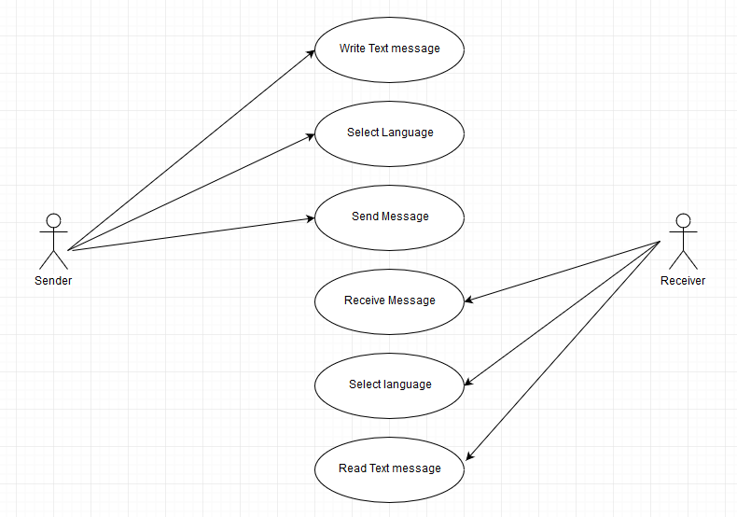
USECASE DIAGRAM
For TEXT:

Slide 9
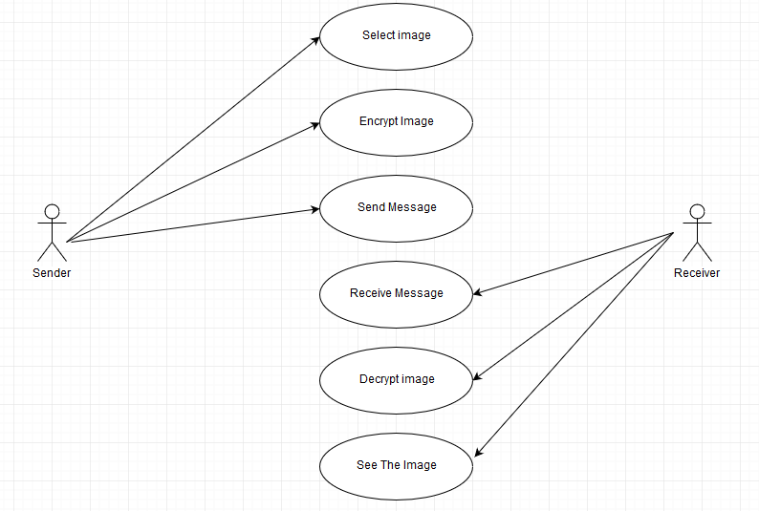
USECASE DIAGRAM
For IMAGE:

Slide 10
PROJECT PLAN

Slide 11
SUMMARY
Steganography is a really intresting subject and outside of the mainstream cryptography and system administration that most of us deal with
Steganography can be used for the hidden communication.
This steganography type provide for the purpose to how to use any type of image format to hide any data inside.

Slide 12
REFERENCES
IEEE PAPER 1(An Improved Approach for LSB-Based Image Steganography using AES Algorithm).
IEEE PAPER 2(Advance Encryption Technique using Color Code Based Substitution).
IEEE PAPER3 ((AES Cryptography in Color Image Steganography By Genetic Algorithms).
Web service: GOOGLE.

Slide 13
THANK YOU

